Slide 1

GMCC Ocean
In House Underwriting
Proprietary & Confidential. For GMCC Mortgage Professionals Only. Distribution is strictly prohibited
V4 12-23-2025

Slide 2
Special
5/6 ARM – 5.875% at par (as of 12-23-2025)-Exclusively for GMCC
Pricing on rate sheet – Send out by Jarrad
Reserve requirements – 3-6 months + additional for departing
Ocean is available in CA, TX, NV
No tax documents needed (no tax return, no w2, no paystubs, no 4506-C)
WVOE, CPA prepared P&L, Borrower prepared P&L
100% gift funds ok for primary only
Citizen, green card holder, and foreign national ok (No EAD card holder at this time)
NO PPP for investment.
Max 10 financed properties
Private landlord VOR OK-No need for proof of rent payment

Slide 3
Programs
      3 ways to qualify:
      WVOE for wage earners (less then 25% ownership in the business)
      CPA prepared P&L
      3) Borrower prepared P&L

Slide 4
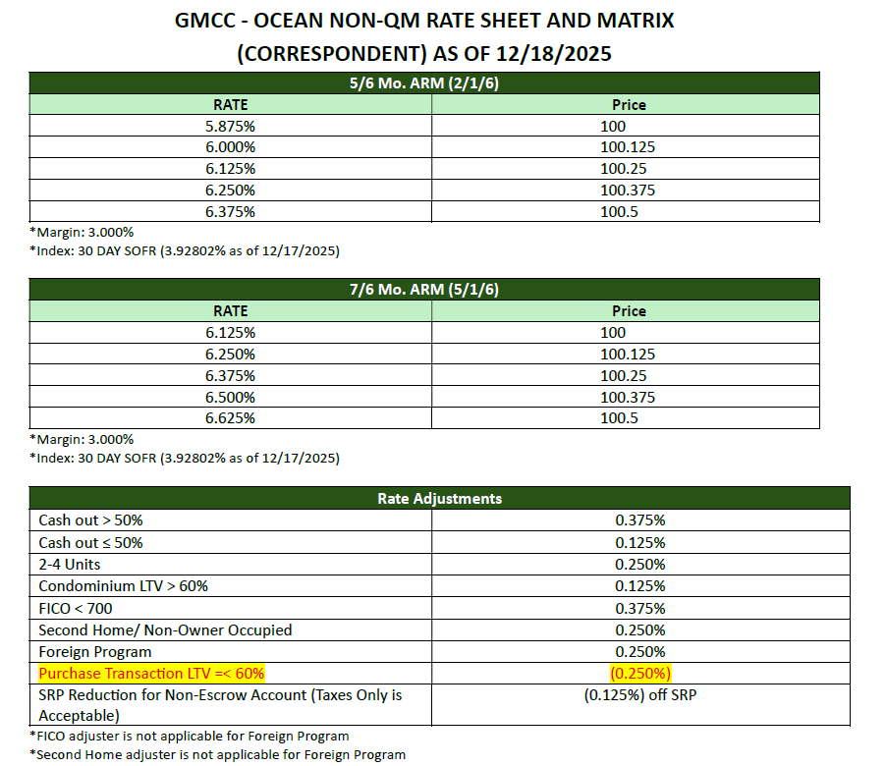
Programs
      No hit for Borrower prepared P&L
      Example:
      US citizen with 700 FICO
      Purchase SFR as primary
      No price adj is needed so pricing is
      5.875% at 100
      0.25% Rate reduction for purchase transaction LTV<=60%

Slide 5
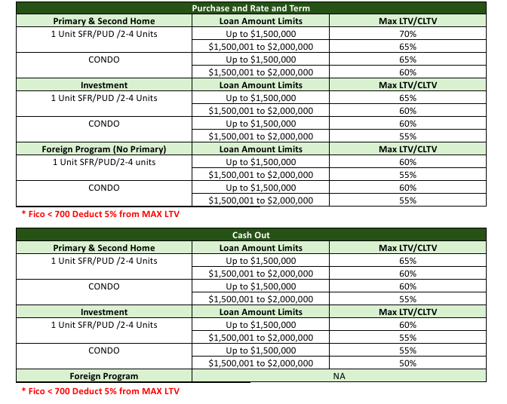
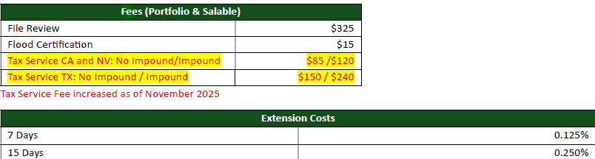
Programs

Slide 6
Eligible borrower
US Citizen
Permanent Resident
Working VISA holder – ok – E1, E2, G1 to G5, H1b, L1
Foreign National ok, no F1 &F2
POA ok – except for foreign national and for cashout transactions.
Co-signor – not allowed
Non-occupant Co-Borrower – ok for primary– must be on title
Tenants in common vesting – not allowed

Slide 7
Eligible borrower
Foreign National
  no borrower prepared p&l
  Need valid visa B1, B1, H2, H3, I, J, K
  Accept ESTA approval(for borrower on VISA Waiver Program)-07-09-2025
  No POA
  No gift funds allowed
  2nd home or investment only
  Funds in US bank
  DTI 38%/38%

Slide 8
Transactions
Purchase – ok
R/T- One borrower must be on title at time of application
List for sales must be withdrawn PRIOR to application
Use appraised value regardless the purchase date.
Cash Out – Current mortgage to be paid off must have 12 months seasoning
One borrower must be on title for 6 months (prior to closing)
List for sales must be withdrawn PRIOR to application
Delayed financing - property purchased within 6 months
priced as cash out

Slide 9
DTI
Max DTI 38/43%, Foreign National – 38/38%
Purchase, R/T or cash out – same DTI requirement

Slide 10
Income
Wage earner
  WVOE (Fannie Mae form) signed by HR, Accounting or owner. Income should be inline with position.
  WVOE must contain: Dates of employment, Position, Prospect of continue employment, based pay amount and frequency.
  requires two years of work history at the same place of employment or in a similar field.

Slide 11
Income
Self Employed
Option 1: Borrower prepared P&L
Need CPA letter for ownership %
Need CPA letter if using business funds
Need 2 years Business License
CPA needs to say they had filed the business tax returns for the last 2 years
Option 2 (For borrower has no business license) CPA prepared P&L
Need CPA letter for ownership %
Need CPA letter if using business funds
CPA needs to say they had filed the business tax returns for the last 2 years
Need LOE to explain business nature

Slide 12
Income
Self Employed –
P&L prepared by tax preparer (CPA, EA, CTEC, PTIN) or by borrower.
    Application date before 7/1 – need YTD and last year (12 mos) P&L
    Application date after 6/30 – need YTD P&L
    P&L must be dated as MM/DD/YYYY – MM/DD/YYYY
  Tax preparer letter (on formal letter head) confirming
    filed borrower’s last 2 years business tax returns
    Confirm borrower has been in business for 2 years or more at the same location(must disclose company name and address)
    Confirm borrower’s business ownership %
    Tax preparer license may be verified
  AND
  2 Years of current business license if using borrower prepared P&L.
  Acceptable business license: a: Professional license, e.g. Real Estate License, Cosmetologist license, Insurance license, Massage therapist license, etc; b: City business license.

Slide 13
Income
Rental income
  Investment Purchase – need rent survey + lease agreement ( if vacant, only 1007 is needed)
  Use 75%
  Short term rental – not allowed
  Using rental for REOs – use 75% of lease agreement
  Using departure rental:
    Use 75% of lease agreement
    Need copy of security deposit check
    Need additional 3 months reserve (based on departing PITIA)

Slide 14
Credit
Min FICO 680 (must have 3 FICO)
2 tradelines with 12 months seasoning
0x30 on VOR or VOM
Bankruptcy/Foreclosures – 4 years
Short sales – 2 years
Non-traditional credit is allowed if not enough tradelines

Slide 15
Assets
1 month of bank statement or VOD (VOD preferred).
100% Gift funds for down payment and cash to close is ok for primary and 2nd home.
Gift funds NOT allowed on Investment purchase.
Gift funds not allowed for Foreign National Borrower.
Gift funds cannot be for reserve.
Large deposit – 50% of monthly income
Stock & bond – value at 70%;
Retirement – value at 70%
Cash out proceeds can be used as reserve

Slide 16
Reserve – Alt Doc
Reserve required as follows:
Primary: 3 months (PITIA reserve by qual rate)
Second/Investment: 6 months (PITIA reserve by qual rate)
Departing home (converted to 2nd home or investment):
- need 6 months reserve (both subject and departing) if departing is less than 20% equity.
- need 2 months reserve (both subject and departing) if departing is more than 20% equity.

Slide 17
Liabilities
Student loan – amount on credit report or 1%
Co-signing liability – can be excluded if showing 6 months payments from other party
HELOC – actual payment
Alimony – deduct from income
Installment – less then 10 payments – do not count

Slide 18
Appraisal
Loan amount<=$1.5M: 1 Appraisal + desk review
Loan amount>$1.5M: 2 Appraisal report
> Max # of financed properties
  Primary, 2nd – no limit
  Investment – 10 financed properties
**The financed property limit applies to the borrower’s ownership of 1-4 units financed properties **
No 4 units + ADU

Slide 19
Business license
Must show at least 2 years + current
Current business license that does not have start date – not useful since cannot prove 2 years in business

Slide 20
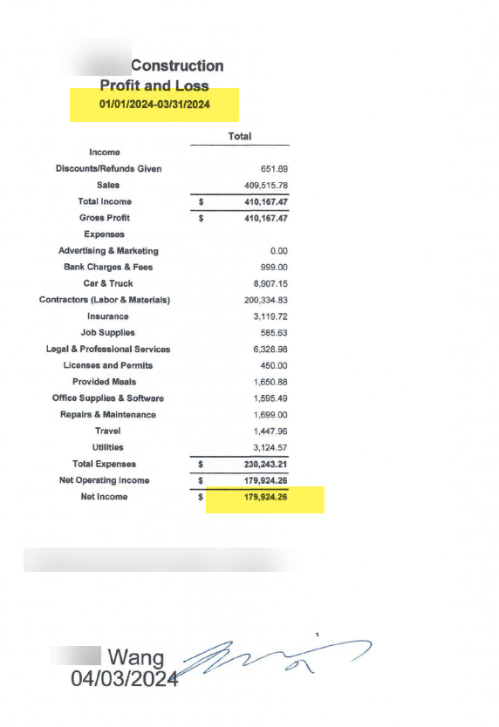
Example

Slide 21
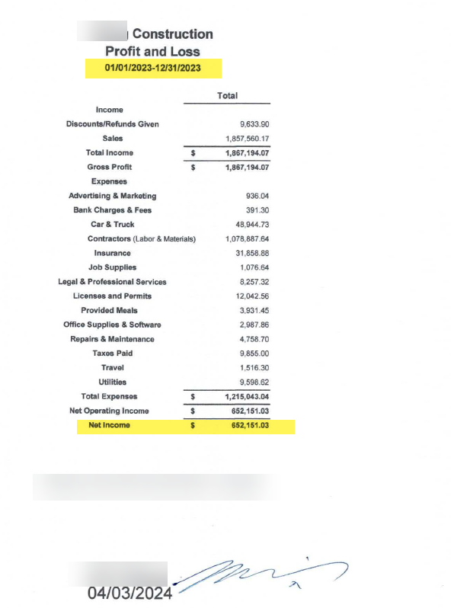
Example

Slide 22
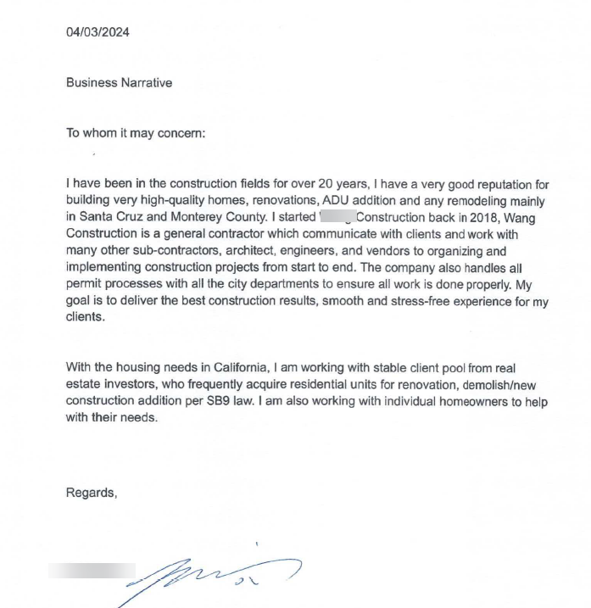
Example

Slide 23
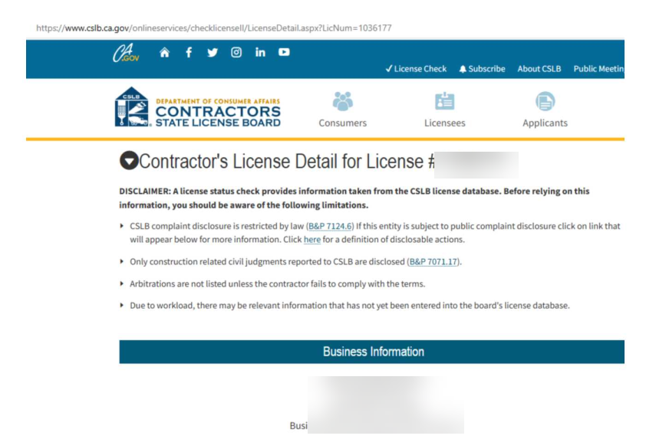
Example

Slide 24
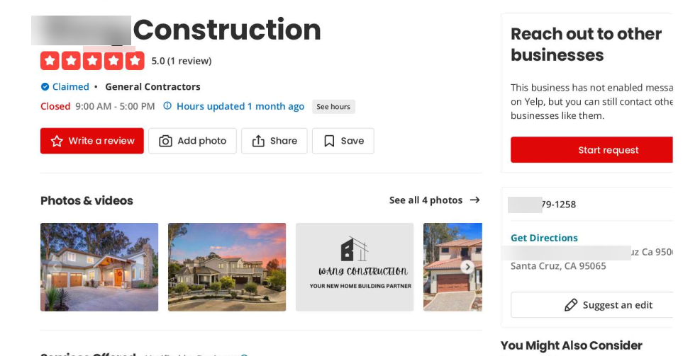
Example

Slide 25
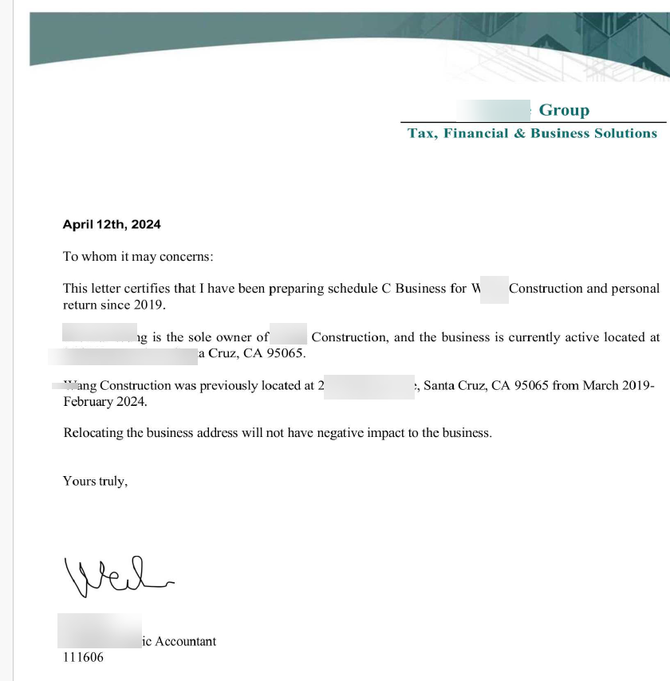
Example

